Slide 1
Introduction to AI
By: Ashok Basnet

Slide 2
Course Outline
Overview
Definition of AI
AI and Related Fields
Brief History of AI
Applications of AI
Importance of AI
Definition of Knowledge and Learning
Importance of Knowledge and Learning

Slide 3
Any Idea on AI?

Slide 4
Definition of AI
AI stands for Artificial Intelligence
It is a branch of computer science that deals with the development of intelligent machines that can perform tasks that typically require human intelligence.
Definition: AI (Artificial Intelligence) can be defined as the simulation of human intelligence processes by computer systems.
This involves the development of algorithms and models that enable machines to perform tasks that would normally require human intelligence, such as visual perception, speech recognition, decision-making, and language translation.
AI systems can also learn and improve over time, using algorithms and data to identify patterns and make predictions.

Slide 5
John McCarthy: John McCarthy is credited with coining the term "Artificial Intelligence" in 1956. He defined AI as "the science and engineering of making intelligent machines."
Marvin Minsky: Marvin Minsky was a pioneer in the field of AI and co-founder of the MIT AI Laboratory. He defined AI as "the science of making machines do things that would require intelligence if done by humans."
Ray Kurzweil: Ray Kurzweil is a futurist and inventor who has written extensively on AI. He defines AI as "the engineering of making intelligent machines, especially intelligent computer programs."
Stuart Russell: Stuart Russell is a leading AI researcher and professor at UC Berkeley. He defines AI as "the development of computer systems that can perform tasks that would normally require human intelligence, such as visual perception, speech recognition, decision-making, and language translation."

Slide 6
Think Humanly: The Cognitive Modelling Approach
The exciting new effort to make computers think… machines with minds, in the full and literal sense. (Haugeland, 1985)
“The automation of activities that we associate with human thinking, activities such as decision-making, problem solving, learning…”(Bellman, 1978)
This approach aims to model human cognition and use this model to create intelligent machines.
Cognitive psychology and neuroscience research are used to understand how humans think, reason, and solve problems.
Needs understanding of how human thinks?
Example: General Problem Solver-GPS (Newell and Simon, 1961)

Slide 7
Act Humanly: The Turing Test Approach
The art of creating machines that perform functions that require intelligence when performed by people.(Kurzwail, 1990)
The study of how to make computers do things at which, at the moment, people are better.(Rich and Knight, 1991)
Based on Turing Test (Alan Turing, 1950)
Test based on indistinguishability from undeniably intelligent entities (human).
The computer passes a test if a human interrogator, after posing some written questions, can’t tell whether the responses were made by a human or not.

Slide 8
Think Rationally: The “Laws of Thought” Approach
The study of mental faculties through the use of computational models. (Charniak and McDermott, 1985)
The study of the computations that make it possible to perceive, reason and act. (Winston, 1992)
Based on Rational Thinking (Right Thinking)
Irrefutable Reasoning Process
Syllogisms providing patterns for argument structures that always yielded correct conclusions
Logic: the Laws of thought
Logicist tradition within AI hopes to build on such programs to create intelligent systems

Slide 9
Act Rationally: The Rational Agent Approach
Computational Intelligence is the study of the design of intelligent agents. (Poole et al., 1998)
AI… is concerned with intelligent behaviour in artifacts. (Nilsson, 1998)
Based on Intelligent Agents
Agents are the things that act.
Computer agents are expected to have other attributes that distinguish them from mere “programs”, such as operating under autonomous control, perceiving their environment, persisting over a prolonged time period, adapting to change, and being capable of taking on another’s goals.
Rational agents are those who act so as to achieve the best outcome or, the best expected outcome when there is uncertainty.

Slide 10
Types of AI
There are three types of AI:
Artificial Narrow Intelligence (ANI)
Artificial General Intelligence (AGI)
Artificial Super Intelligence (ASI)
ANI refers to AI that is designed for a specific task, such as speech recognition or image classification.
AGI refers to AI that is capable of performing any intellectual task that a human can.
ASI refers to hypothetical AI that surpasses human intelligence in every possible way.

Slide 11
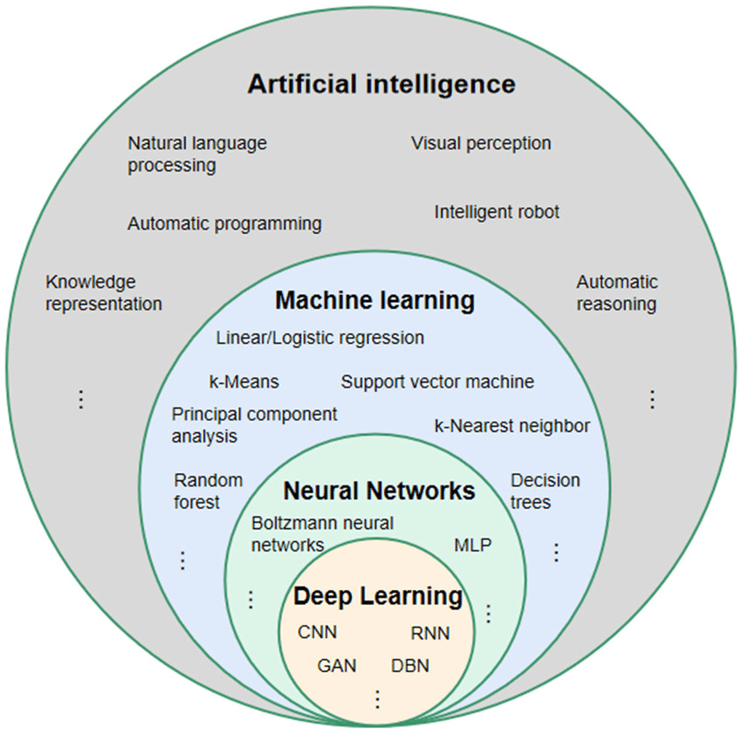

Slide 12
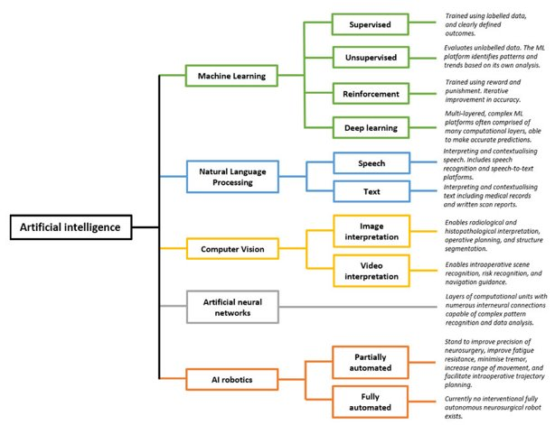

Slide 13
AI and Related Fields
Computer Science:
AI is rooted in computer science, which provides the hardware and software infrastructure that enables AI systems to operate.
Mathematics:
Mathematics plays a central role in AI, as it provides the foundation for algorithms and models used in machine learning and other AI techniques.
Statistics:
Statistics is used extensively in AI to analyze data and make predictions about future outcomes.
Logic:
Logic is used in AI to represent and reason about knowledge and decision-making.
Neuroscience:
AI researchers draw inspiration from neuroscience to model the behavior of the brain and develop algorithms for learning and decision-making.

Slide 14
AI and Related Fields
Philosophy:
AI raises many philosophical questions, such as the nature of consciousness, intelligence, and free will.
Philosophical inquiry helps to shape the goals and ethical considerations of AI research.
Linguistics:
Natural language processing, a key area of AI, draws heavily on the field of linguistics to understand and generate human language.
Psychology:
AI researchers also draw inspiration from psychology to model human cognition and behavior, and to design intelligent systems that can interact with humans in natural and intuitive ways.

Slide 15

Brief History of AI
1943
Warren McCulloch and Walter Pitts created the first artificial neuron model, which became the basis for future neural networks.
1950
Alan Turing published a paper titled "Computing Machinery and Intelligence," in which he proposed the Turing Test.
1956
The term "artificial intelligence" was first used by John McCarthy, Marvin Minsky, Nathaniel Rochester, and Claude Shannon at the Dartmouth C

Slide 16
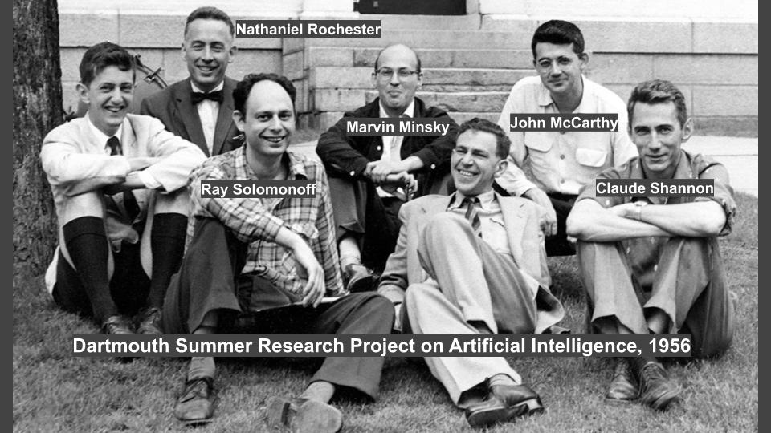

Slide 17

Brief History of AI
1958
John McCarthy invented the Lisp programming language, which became the main language for AI research.
1964
Joseph Weizenbaum created ELIZA, a computer program that could simulate a conversation with a human and is considered one of the earliest examples of natural language processing (NLP).
1969
Shakey, the first mobile robot capable of reasoning about its own actions, was developed at the Stanford Research Institute.
1975
The first expert system, MYCIN, was developed at Stanford University to diagnose blood infections.

Slide 18
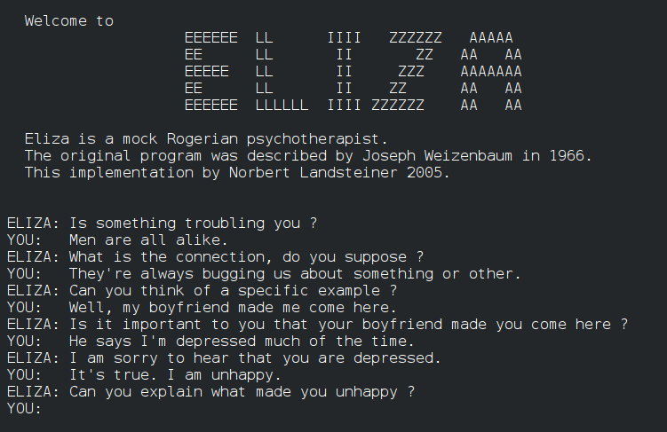

Slide 19
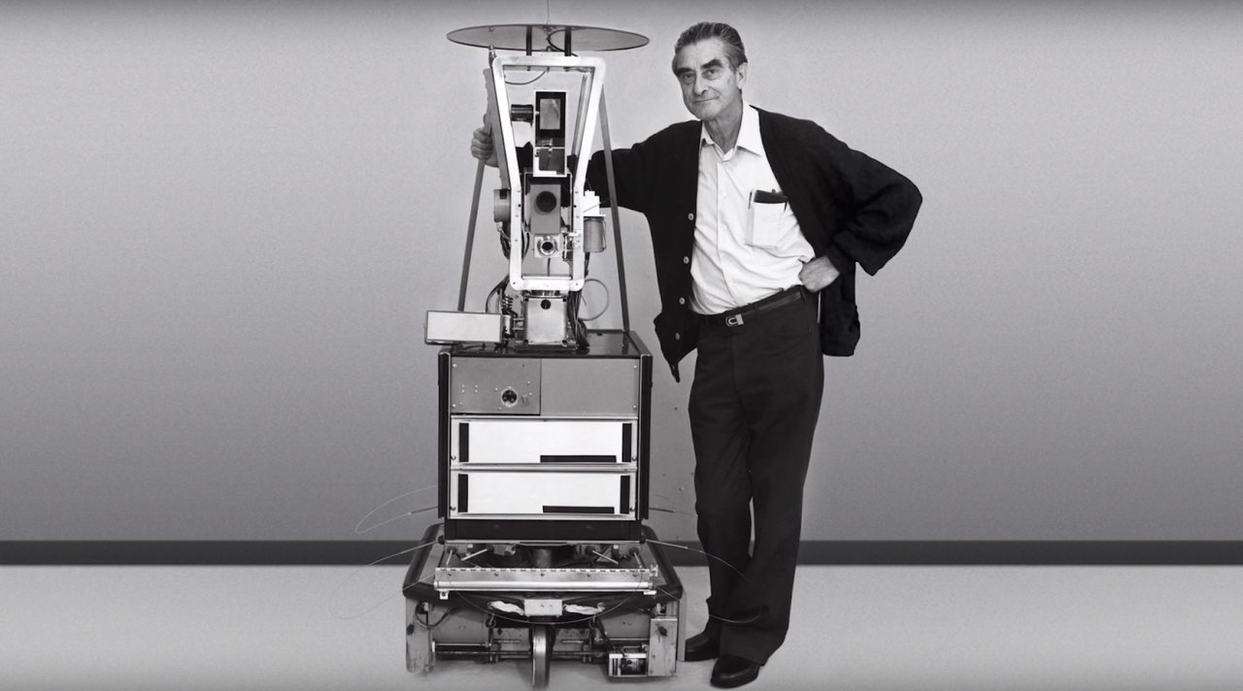

Slide 20

Brief History of AI
1981
The first autonomous vehicle, the Navlab, was developed by Carnegie Mellon University.
1997
IBM's Deep Blue defeated chess champion Garry Kasparov, marking the first time a computer beat a human world champion in a game of chess.
2011
IBM's Watson defeated human champions in the game show Jeopardy!

Slide 21


Slide 22

Brief History of AI
2012
Google's DeepMind developed a neural network called AlexNet, which achieved a significant breakthrough in image recognition.
2016
AlphaGo, a program developed by DeepMind, defeated the world champion in the board game Go.
2018
OpenAI's GPT-2, a language model capable of generating human-like text, was released.
2020
GPT-3, a more advanced language model than GPT-2, was released by OpenAI.

Slide 23
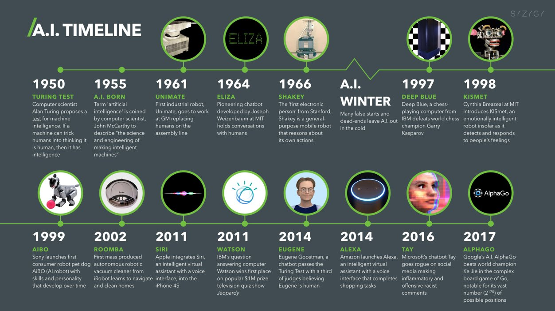

Slide 24
Brief History of AI: Success Stories
Chess-playing computers: In 1997, IBM's Deep Blue computer defeated the reigning world chess champion, Garry Kasparov, in a six-game match.
Speech recognition: Voice assistants like Siri, Alexa, and Google Assistant have become ubiquitous in recent years.
Autonomous vehicles: Companies like Tesla and Waymo have made significant progress in this area.
Medical diagnosis: AI algorithms can analyze medical images, such as CT scans and X-rays, to identify potential issues and help doctors make more accurate diagnoses.
Fraud detection: AI can analyze large datasets to identify patterns and anomalies that might indicate fraudulent activity, and this can help prevent financial losses and protect consumers.

Slide 25

Heros of AI

Slide 26


Slide 27
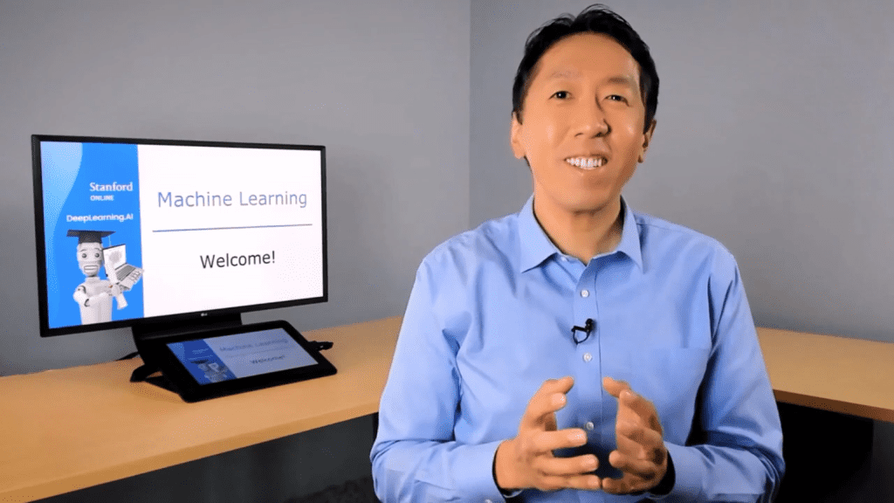

Slide 28

Applications of AI
AI is used in various industries, including healthcare, finance, and transportation.
In healthcare, AI is used for medical image analysis and drug discovery.
In finance, AI is used for fraud detection and risk assessment.
In transportation, AI is used for self-driving cars and traffic management.

Slide 29
Importance of AI
Automation: AI is capable of automating repetitive and mundane tasks, allowing humans to focus on more complex and creative work.
Decision-making: AI can process large amounts of data and make complex decisions based on that data.
Personalization: AI can analyze data about individual preferences and behaviors to personalize products and services.
Improved healthcare: AI can help doctors and medical professionals make more accurate diagnoses and develop more effective treatment plans.

Slide 30
Importance of AI
Increased safety: AI can be used to improve safety in a variety of industries, including transportation, manufacturing, and construction.
Advancements in science and research: AI can help scientists and researchers process large amounts of data and make new discoveries. This can accelerate scientific progress and lead to new breakthroughs in a variety of fields.
Addressing global challenges: AI can be used to address some of the world's most pressing challenges, such as climate change, poverty, and disease.

Slide 31

Challenges of AI
One of the biggest challenges of AI is ethical concerns, such as bias and privacy.
There are also concerns about the impact of AI on jobs and the economy.
Another challenge is the lack of transparency in how AI systems make decisions, which can make it difficult to understand and trust them.

Slide 32
Conclusion
AI has the potential to transform various industries and improve our lives in many ways.
However, it also poses significant challenges that need to be addressed.
It is important to continue to develop AI in a responsible and ethical manner to ensure its benefits are maximized and its risks are minimized.

Slide 33
Data, Information, Knowledge and Wisdom
Data, information, knowledge, and wisdom are hierarchical concepts that represent different levels of understanding or processing of information.
Data:
Data is a collection of facts or observations that are typically in a raw and unorganized form.
For example, a list of numbers or a spreadsheet containing sales figures for a particular month is data.
Information:
Information is data that has been processed, organized, and presented in a meaningful way.
For example, if we take the sales figures from the previous example and organize them into a bar graph or a table, we now have information that can be used to understand how sales have changed over time.

Slide 34
Data, Information, Knowledge and Wisdom
Knowledge:
Knowledge is information that has been assimilated and understood by a person.
It involves connecting different pieces of information to form a deeper understanding.
For example, if a sales manager examines the sales figures and identifies a trend that sales tend to increase during certain times of the year, they have gained knowledge about the sales patterns of the company.
Wisdom:
Wisdom is the highest level of understanding, and it involves using knowledge to make judgments and decisions.
It is a more holistic and subjective understanding of a situation, based on experience, intuition, and reflection.
For example, a wise sales manager might use their knowledge of the company's sales patterns to make strategic decisions about when to launch new products or promotions.

Slide 35
Learning
In AI, learning refers to the process of improving a machine's performance on a particular task by providing it with examples or feedback.
There are several types of learning in AI, including supervised learning, unsupervised learning, and reinforcement learning.
In supervised learning, the machine is provided with labeled examples of inputs and outputs, and it learns to make predictions based on those examples.
In unsupervised learning, the machine is not given labeled examples, and it must find patterns or structures in the data on its own.
In reinforcement learning, the machine learns by receiving feedback in the form of rewards or punishments, based on the actions it takes.

Slide 36

Thank you

